Slide 1



Slide 2
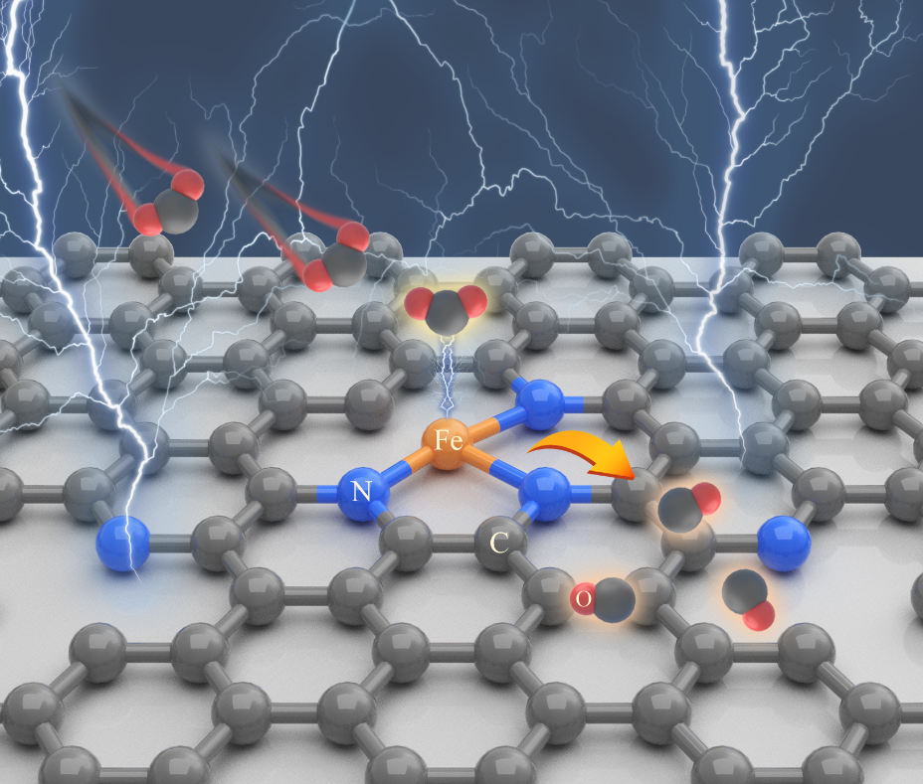
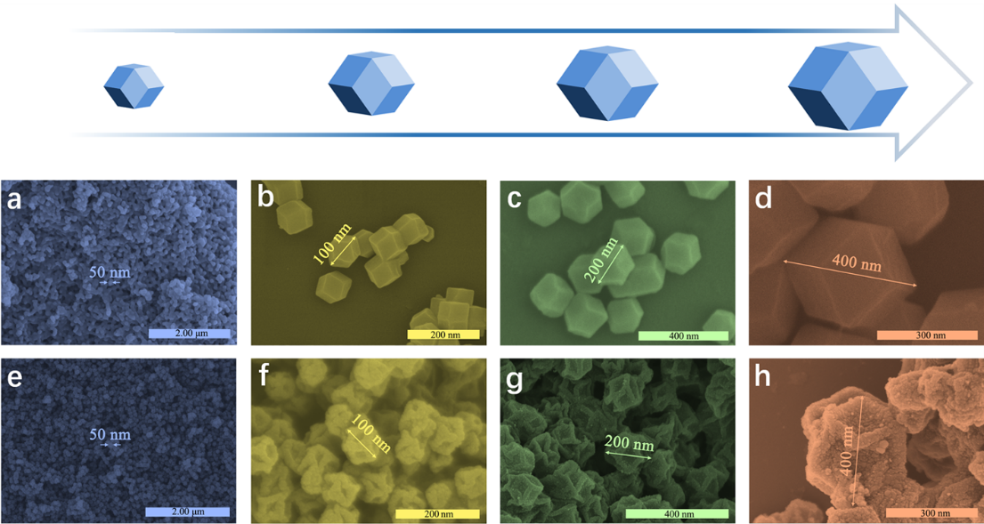
Gas Diffusion Strategy for Inserting Atomic Iron Sites into Graphitized Carbon Supports for Unusually High Efficient CO₂ Electroreduction and High-Performance Zn-CO₂ Batteries
Tingting Wang, Bin Yang*, Liming Dai*, Yang Hou*
*Corresponding Author: yhou@zju.edu.cn
ABSTRACT: Emerging single atom catalysts (SACs) hold great promise for CO2 electroreduction (CO2ER), but the design of highly active and cost-efficient SACs is still challenging. Herein, we developed a gas diffusion strategy, along with one-step thermal activation, for fabricating N-doped porous carbon polyhedrons with trace isolated Fe atoms (Fe1NC). The optimized Fe1NC/S1-1000 with atomic Fe-N3 sites supported by N-doped graphitic carbons exhibits superior CO2ER performance with the CO Faradaic efficiency up to 96% at −0.5 V, turnover frequency of 2,225 h⁻¹, and outstanding stability, outperformed almost all
previously-reported SACs based on N-doped carbon supported non-precious metals. The observed excellent CO2ER performance is attributed to the greatly enhanced accessibility and intrinsic activity of active centers due to the increased electrochemical surface area through size modulation and the redistribution of doped N species by thermal activation. Experimental observations and theoretical calculations reveal that the Fe-N3 sites possess balanced adsorption energies of *COOH and *CO intermediates, facilitating the CO formation. A universal gas diffusion strategy is used to exclusively yield a series of dimension-controlled carbon-supported SACs with single Fe atoms while a rechargeable Zn-CO2 battery with Fe1NC/S1-1000 as cathode is developed to deliver a maximal power density of 0.6 mW cm⁻².
Synthesis of Fe1NC Catalysts
Figure 1. (a) Schematic illustration of synthetic procedure for gas diffusion strategy. (b) HRTEM and (c) amplified HRTEM images of Fe₁NC/S₁-1000 (insert: corresponding SAED pattern). (d) Raman spectrum of Fe₁NC/S₁-1000. (e) Elemental mapping images of Fe₁NC/S₁-1000 confirming the co-existence of C, N, O, and Fe elements. (f) Aberration-corrected HAADF-STEM image of Fe₁NC/S₁-1000. (g) N₂ adsorption/desorption isotherm curve of Fe₁NC/S₁-1000. Inset: DFT pore size distribution of Fe₁NC/S₁-1000.
e f
Structural and Catalytic Properties of Fe1NC Catalysts.
d
e
f
Figure 2. (a-d) FESEM images for ZIF-8/S_{X} series. (e-h) FESEM images for Fe₁NC/S_{X}-1000 series derived from corresponding ZIF-8/S_{X} series.
Figure 3. (a-b) FECO of Fe1NC/S1-Y series, NC/S1-1000 and Fe1NC/SX-1000 series. (c) FECO of Fe1NC/S1-1000, highlighted by the shaded region, compared to that of other reported state-of-the-art non-precious metal/N-doped carbon based SACs. (d) XANES spectra at the Fe K-edge and (e) k³-weighted χ(k)-function of the EXAFS spectra of Fe₁NC/S₁-Y series with FePc, Fe₂O₃, and Fe foil as the references, confirming the atomic dispersion of Fe species in these samples. (f) Fourier transform-EXAFS fitting results of Fe₁NC/S₁-1000.
Figure 4. (a-e) High-resolution XPS N 1s spectra of Fe₁NC/S₁-Y series, NC/S₁-1000, and ZIF-8/S₁, which are divided into five Voigt-type line-shape peaks with the Shirley background. (f) Doped N distributions of Fe₁NC/S₁-Y series, NC/S₁-1000, and ZIF-8/S₁ obtained from XPS measurements.
Zn-CO2 Batteries with Fe1NC Catalysts.
ACKNOWLEDGMENTS
Y. Hou thanks the support of NSFC 51702284, 21878271, 21878270, and 21961160742, and Zhejiang Provincial Natural Science Foundation of China (LR19B060002), the Fundamental Research Funds for the Central Universities, and the Startup Foundation for Hundred-Talent Program of Zhejiang University. L. Dai is grateful for the partial support by ARC (DP 190103881 and FL 190100126).
Figure 5. (a) Schematic configuration of ZCB with Fe1NC/S1-1000 cathode. (b) Photograph of assembled ZCB exhibiting a maximum open circuit voltage of 0.727 V measured with a voltammeter. (c) Digital photograph of a LED (rated voltage: 2.0 V) illumed by three ZCBs in series with Fe1NC/S1-1000 cathode.

